Slide 1
Husky Climaters
Arjun Malarmannan and Pramoth Guhan

Slide 2
Disclosure
Disclosure:
We (Husky Climaters) are working for MIT Hackathon organized by Global Energy Monitor. We give all the rights to organizers and GEM and concerned parties to use this research and can built it further. We are making it available in submission platform to develop this work and take ahead for betterment for society.
Acknowledgement:
We thank Northeastern University, NU Energy Systems and GSG for letting us know about the Hackathon.

Slide 3
Contents
Dashboard
Job portal
Machine learning model sample for health impact assesment

Slide 4
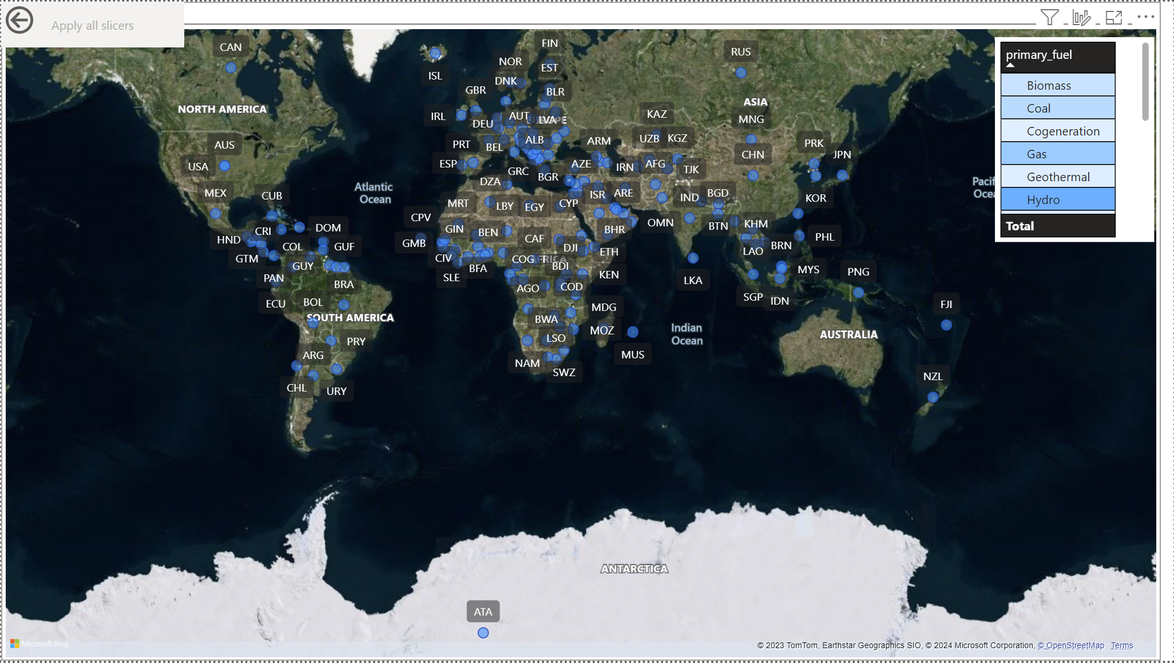
Dashboard
https://app.powerbi.com/groups/me/reports/85dd159e-92d3-42dd-b5ff-08bffd5ee2ee/ReportSection?experience=power-bi

Slide 5
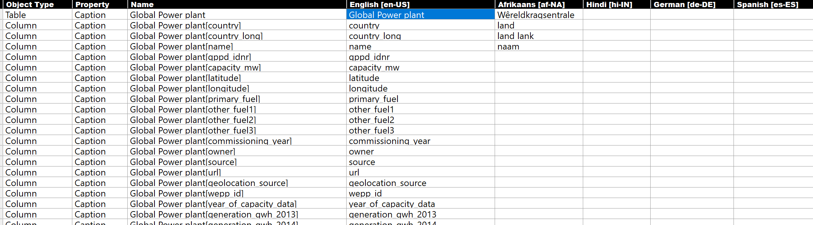
Dashboard : What does it do?
Filters for powerplant types, country and Energy levels.
Language is available in various language (including metadata conversion)
Alternate Text
Visual color for all audience

Slide 6
Dashboard: What it does not do?
Filter for location is in development stage.
Approach used Haversine Formula for finding location.
No live data.
This work can be converted for a live data using continuous flow data.

Slide 7

Jobs in Power plants
Worked in HTML, CSS, JS and Python for creating Energy only dashboard.
Privacy restriction applied.

Slide 8
Querying techniques in Search Engines
Use quotation marks around specific phrases to get more precise results.
Use the "+" operator to include essential terms and the "-" operator to exclude unwanted terms.
Specify desired languages in your search query.
Search for jobs on company websites of major power plant operators.
Consider the type of power plant (nuclear, solar, wind, etc.) when searching.
Use job aggregators like Indeed, Glassdoor, and Monster to broaden your search.

Slide 9
Examples of Job search queries
Basic Queries
"power plant jobs" + "global"
"power plant careers" + "worldwide"
"jobs in power generation" + "international“
Refined Queries
"power plant operator jobs" + "Europe" (Specify a job title and region)
"renewable energy jobs" + "power plants" + "Asia" (Specify a type of power plant and region)
"job boards for power plant engineers" + "international" (Target specific job boards)
"LinkedIn power plant jobs" + "global" (Use a professional networking platform)

Slide 10
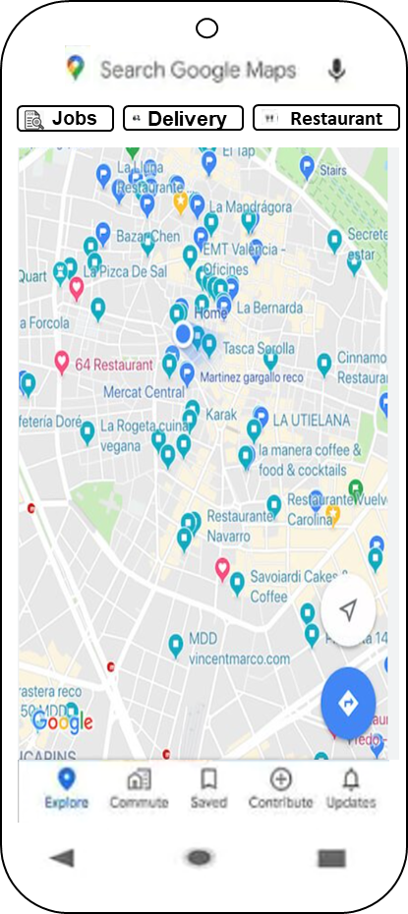
Future looks like Powerplant Jobs in Google Maps

Slide 11
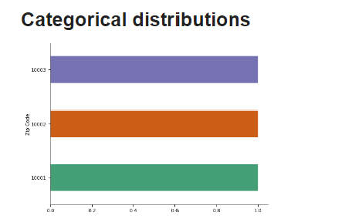
First order Model for Health impact
Variables: Emission, wind speed, population data
Population:
https://colab.research.google.com/drive/1AOWjRTvPQBNfM9dIRFonq0-EEsx3B3ko?usp=sharing

Slide 12
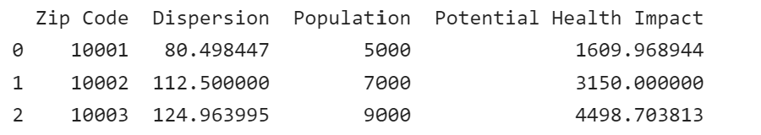
Health effect Impact (Exposure- response relationship)
impact_data["Potential Health Impact"] = impact_data["Dispersion"] * susceptibility * impact_data["Population"] * 0.001

Slide 13

Conclusion
Wind dispersion and population play a major factor in health impact.
There are varies factors which play factor.
We can predict the cancer and respiratory diseases caused by wind pollution by tuning this model accurately.

